Slide 1
Accident Prevention Master (Drowsiness and Yawn Detector)
SUBMITTED BY:
SANJOT KAUR(07013203117)
SANTA SINGH (07113203117)
SIMRANJEET KAUR (07613203117)
SNEHPREET KAUR (08113203117)
IT-2

Slide 2
CONTENT
Why We Need This?
Introduction
Technologies used
Dataset Used
Concepts used
How our Algorithm works?
Flow Chart
Use case diagram
Steps involved and screenshots
Limitations

Slide 3
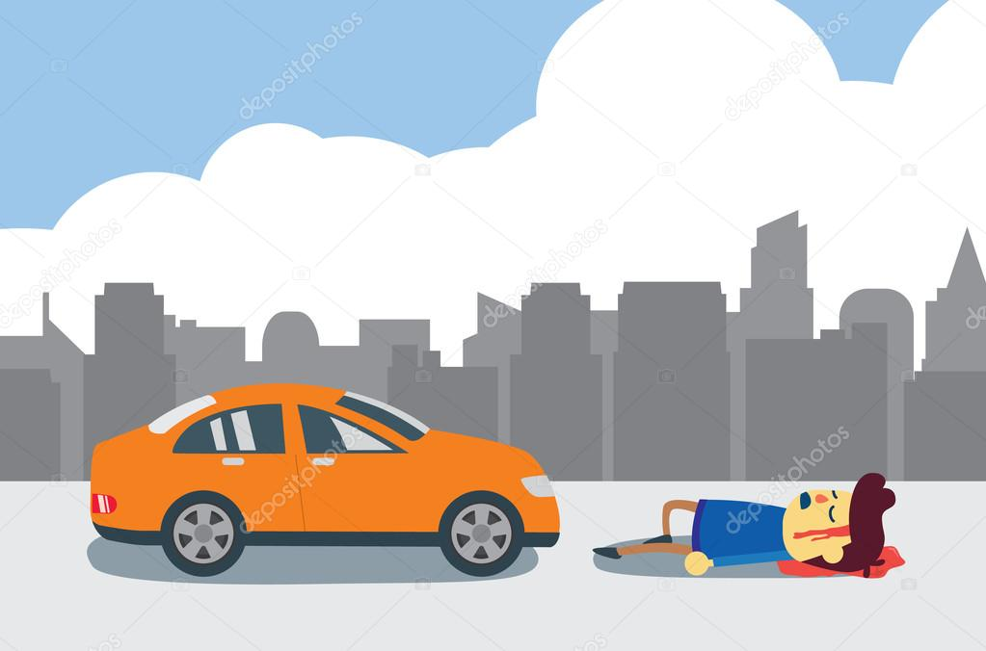
Why We Need This?
Nearly 100,000 car crashes happen each year, 71,000 injuries and 800 fatalities, and a 125 crore cost . Young adults between the ages of 18–29 are even more likely to drive when drowsy, with a reported 71 percent compared to approximately half of those in the age range 30 to 64.
Accidents occur due to driver’s neglected vigilance which becomes serious than other types of accidents, since sleepy drivers often do not take evasive action prior to a collision. Monitoring the driver’s level of vigilance and alerting the driver when he is not paying adequate attention to the driving is the main matter of concern in order to prevent accidents.
A solution to this problem is to identify when a driver is falling asleep, and alarm the driver and passengers of the situation so that appropriate measures can be taken.

Slide 4
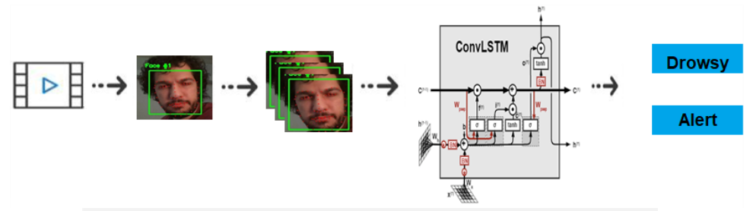
Introduction
Our Project has two main concepts :-
Drowsiness detector
Yawn detector
Drowsiness detection is all about detecting drowsiness(sleepy and lethargic; half asleep). The model we used is built with keras using Convolutional Neural Networks (CNN) which is proposed to detect the states of the eyes and mouth from the ROI images. The percentage of eyelid closure over the pupil over time (PERCLOS) and mouth opening degree (POM) are two parameters used for fatigue detection.
Yawn Detection is all about detecting yawn( open one’s mouth wide and inhale deeply due to tiredness or boredom) using OpenCV , Dlib and Cascade Classifier. It can be used in various major applications like Self Driving Cars, Driver’s Fatigue detection, Driver’s Drowsiness detection, Driver’s consciousness detection etc.

Slide 5
Technologies Used
1. PYTHON:
The main technology used in the project is PYTHON. The Python language has diversified application in the software development companies Some important features of python are as follows : Simple, Extensive Support Libraries, Less lines of Code, Large Community, Integration Feature
2. COMMAND PROMPT:
Command Prompt is a command line interpreter application available in most Windows operating system. It's used to execute entered commands.
3. MACHINE LEARNING:
Machine learning (ML) is a type of artificial intelligence that allows software applications to become more accurate at predicting outcomes without being explicitly programmed to do so. Machine learning algorithms use historical data as input to predict new output values.
4. IMAGE PROCESSING:
In computer science, digital image processing is the use of computer algorithms to perform image processing on digital images.In our program we used Dlib, a pre-trained program trained on the dataset to detect human faces using the pre-defined 68 landmarks.After passing our video feed to the dlib frame by frame, we are able to detect left eye and right eye features of the face.Now, we drew contours around it using OpenCV.

Slide 6
Dataset Used
Dataset
For Drowsiness Detector:
The dataset used for this model is created by us. To create the dataset, we wrote a script that captures eyes from a camera and stores in our local disk. We separated them into their respective labels ‘Open’ or ‘Closed’. The data was manually cleaned by removing the unwanted images which were not necessary for building the model. After training the model on our dataset, we have attached the final weights and model architecture file “models/cnnCat2.h5”.
Now, you can use this model to classify if a person’s eye is open or closed.
For Yawn Detector: shape_predictor_68_face_landmarks.dat
Existing facial databases cover large variations including: different subjects, poses, illumination, occlusions etc.

Slide 7
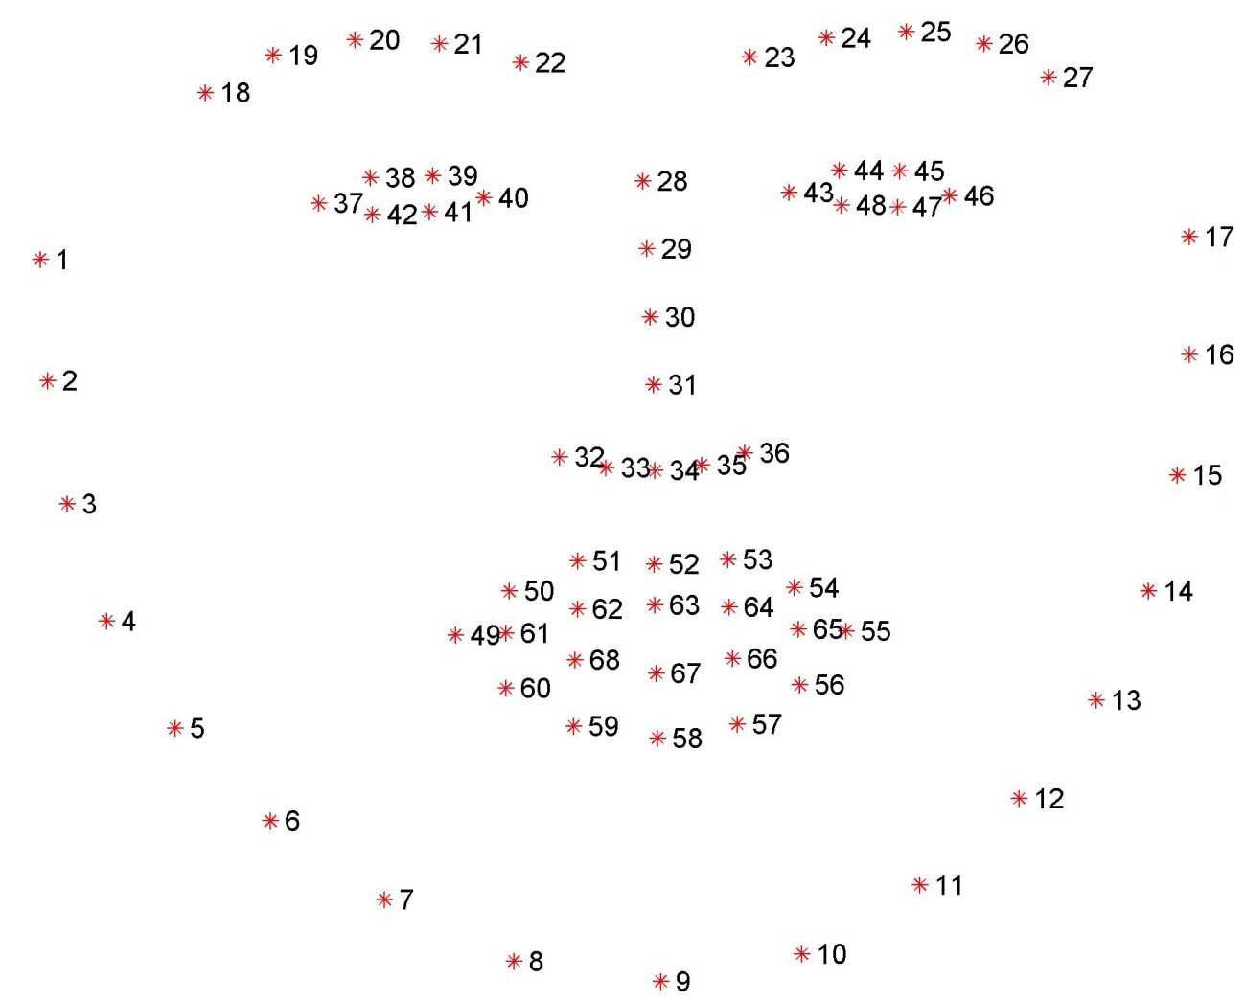
Concepts used
Numpy: Pre-requisite for Dlib
Scipy: Used for calculating Euclidean distance between the eyelids.
Playsound: Used for sounding the alarm
Dlib: This program is used to find the frontal human face and estimate its pose using 68 face landmarks.
Imutils: Convenient functions written for Opencv.
Opencv: Used to get the video stream from the webcam, etc.

Slide 8
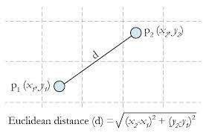
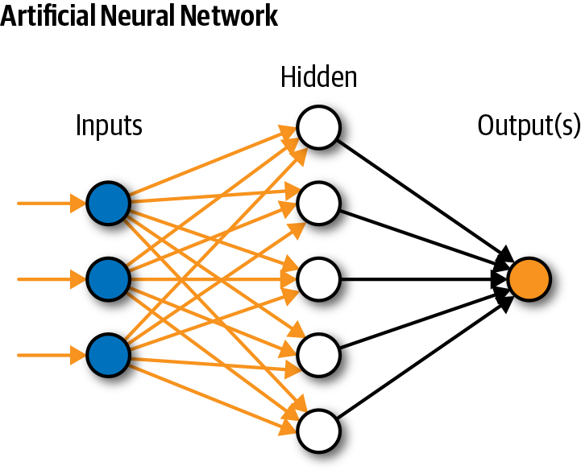
Convolutional Euclidean Distance Neural Network
In deep learning a convolutional neural network (CNN/ConvNet) is a class of deep neural network most commonly applied to analyze visual imagery.
Euclidean Distance represents the shortest distance between two points.
Here’s the formula for Euclidean Distance:

Slide 9
HOW OUR ALGORITHM WORKS?
Step 1 – Take Image as Input from a Camera
Step 2 – Detect Face in the Image and Create a Region of Interest (ROI)
Step 3 – Detect the eyes from ROI and feed it to the classifier
Step 4 – Classifier will Categorize whether Eyes are Open or Closed
Step 5 – Calculate Score to Check whether Person is Drowsy

Slide 10
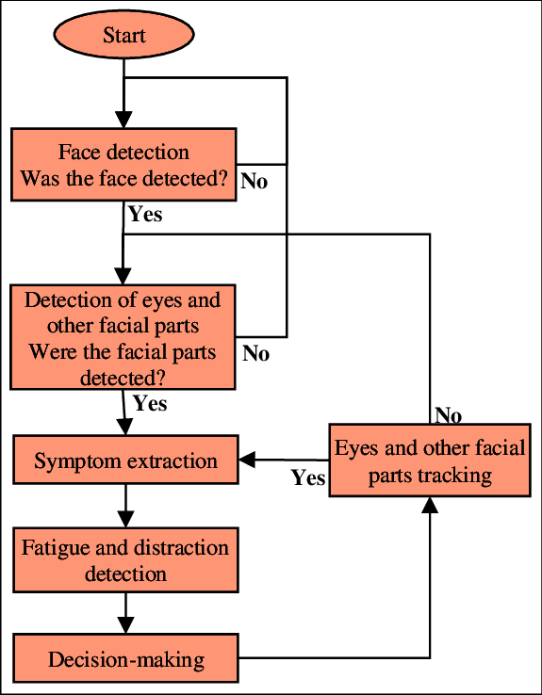
Flow Chart

Slide 11
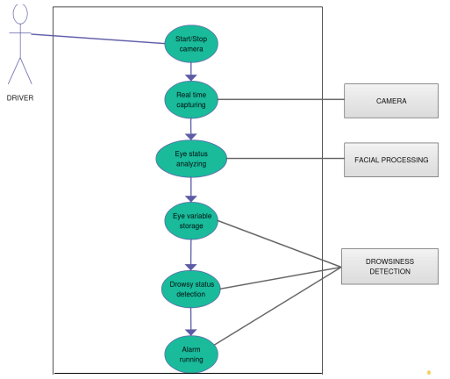
Use Case Diagram

Slide 12
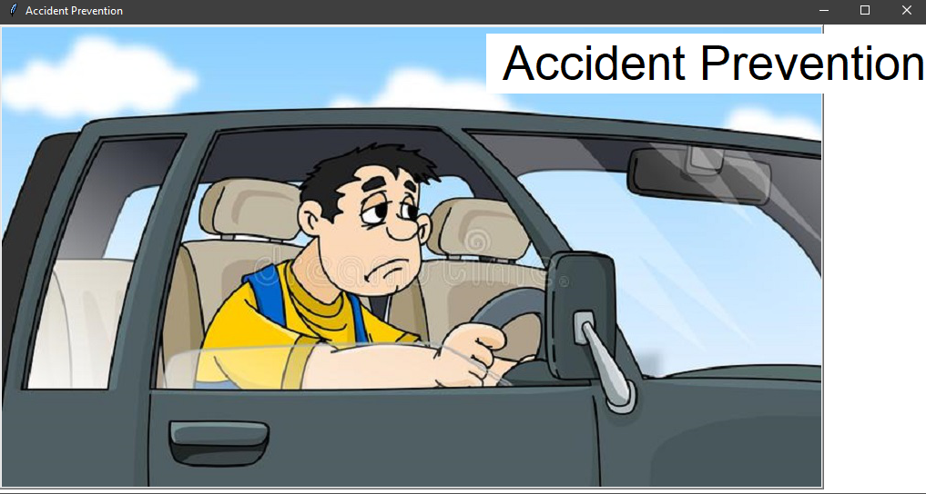
Welcome Page

Slide 13
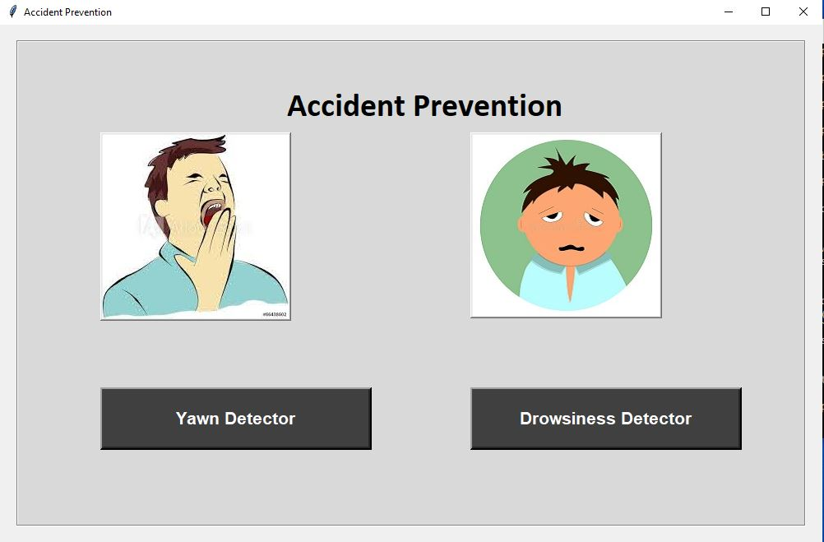

Slide 14
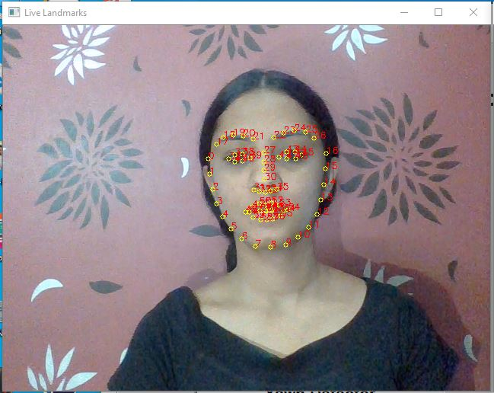
Facial Landmarks for Yawn Detector

Slide 15
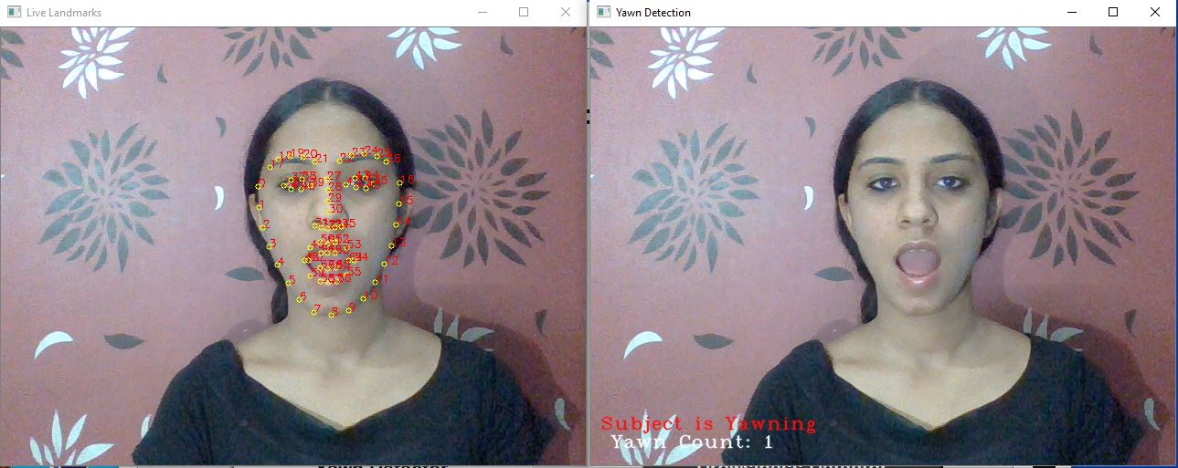
Yawn Count is 1 after detecting lips wide open

Slide 16
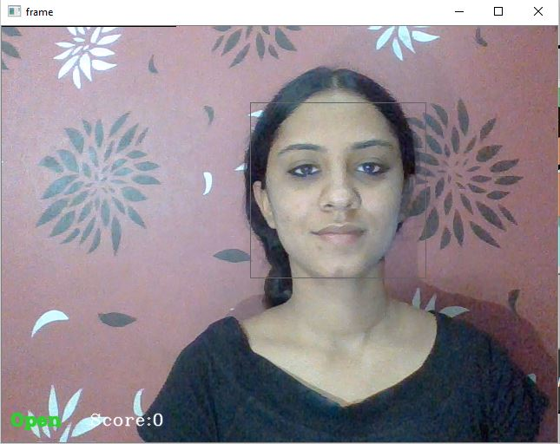
Drowsiness Detector:
When Eyes are Open No Alarm has Raised

Slide 17
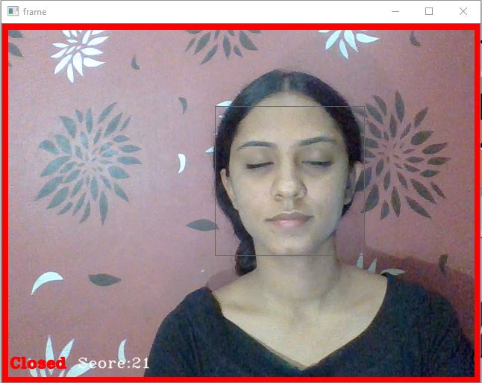
When score is greater than 15, a warning sign and alarm will be raised

Slide 18
LIMITATIONS OF THIS PROJECT
The vehicle type, driver experience, geometric characteristics and state of the road can sometimes produce interference.
GUI is only in English, which can be a language barrier for few individuals

Slide 19
Thank you

